Slide 1


Using rapid evaluative learning processes to influence primary healthcare practice
Learnings from the Auckland Equipped pilot
A Field², J Bycroft¹, C Palmer¹, K Healey¹, M Ghafel¹,
K Arcus², L Dale-Gandar², G Humphrey¹
¹ Auckland District Health Board
² Synergia Ltd
Paper presented to 2011 Australasian Evaluation Conference, 31 August – 2 September 2011

Slide 2
Today’s presentation
The challenge
What is a collaborative?
Equipped – the LTC Collaborative in Auckland
Evaluation findings
Key learnings – in what ways can rapid evaluative learning processes support improvements in practice?

Slide 3

Prevalence of long-term conditions
The NZ Health Survey identified the population diagnosed by a doctor with a health condition expected to last 6 months or more
Within NZ, LTCs account for 70-86% of all deaths and 70-78% of all health care spending

Slide 4

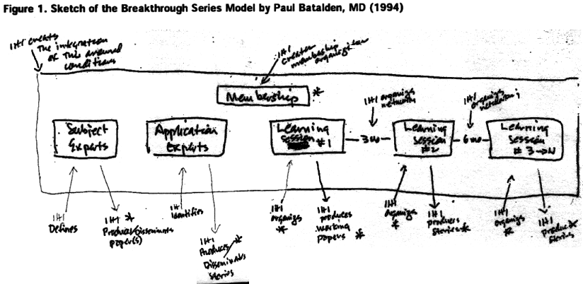


What is a Collaborative?
Developed in 1995, a Collaborative is a specific method of quality improvement used to distribute and adapt existing knowledge to multiple groups to achieve a common aim
It promotes rapid change, allowing participants to experience the benefits and create results in a short time-frame
Paul Batalden & Don Berwick, Institute of Healthcare Improvement (IHI)
Notes:
4
Looking at Collaboratives in more detail:
Notes:
Is about not re-inventing the wheel
Bringing people together to share and learn using existing examples which have already been tried and tested
Its not a research project its about doing

Slide 5
Why do a Collaborative?
Gap between what is known in best practice and what is often delivered (low fidelity)
Ensuring systematised care for comparable populations
Learn from examples of excellent performance
Disseminate principles of best practice
Valuing insights across professional boundaries
Improve the overall system of care

Slide 6
Key Features of a Collaborative
Proven improvement model for rapid & sustainable improvement
Expert Advisory Panel – subject & QI experts
Use of information and measurement to guide improvement work
Clinical leadership and focus on clinical practice
Protected time
Practical support from QI facilitators
Encourages individuals with practices to change

Slide 7
Outcomes
Typically see improvements in:
  Patient care & health outcomes
  Safety
  Efficiency & effectiveness
  Reporting & functionality
  Teamwork & staff morale
  Systems & processes
  Right person for right role
  Job satisfaction
  Relationships with community, primary and secondary care
Supports culture shift to continuous quality improvement

Slide 8
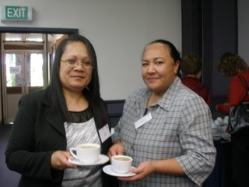

Long-Term Conditions Collaborative
Can busy practices within ADHB region implement a long term conditions collaborative and adopt QI approaches?
If so, would their patients benefit?

Slide 9
The improvement model
Thinking part
Doing part

Slide 10
PDSA Cycle(s)
What will you take forward from this cycle?
What, who, when, where, predictions, data collected
Act
Plan
Study
Do
Was plan executed?
Review and reflect on results

Slide 11
PDSA (Plan – Cycle 1)
Plan:
What: Run a search of database for patients prescribed a CVD medication who are not coded with a CVD diagnosis. Give GP a copy of the list to confirm diagnosis and code appropriately
Who: Kathy
When: Friday 21st August
Where: At the practice
Prediction: That a number of patients not coded will be identified
Data to be collected: List of patients to be checked and correctly coded with a diagnosis of CVD

Slide 12
PDSA (Do, Study, Act – Cycle 1)
Do: Plan was completed.
Study: 25 patients were identified as having been prescribed a statin but were not coded as having CVD. (15 did have CVD, 10 did not)
Act: GPs to correctly code patients with CVD diagnosis where appropriate.

Slide 13
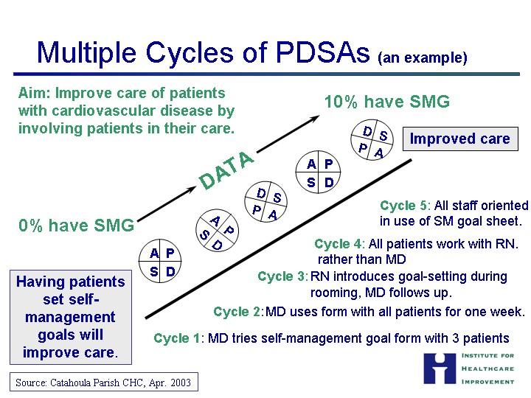

Slide 14
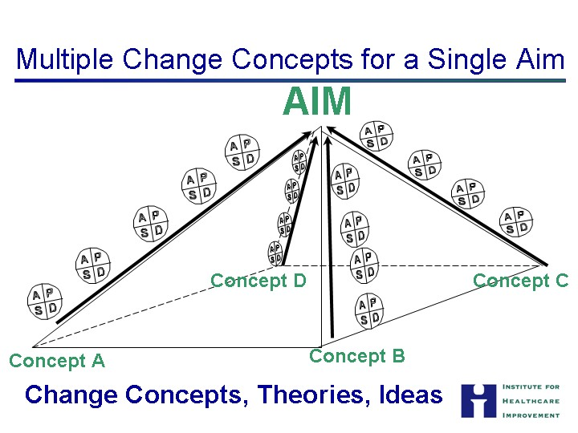

Slide 15
The Auckland Approach
First time Breakthrough Series trialled in New Zealand
Three topic areas
  System redesign, cardiovascular disease/diabetes, self-management support
15 practices from five Auckland Primary Healthcare Organisations (PHOs)
3 learning workshops of 1.5 days were offered
  Supported by networking sessions
  PHO facilitators
  ADHB staff
  An expert advisory group
  Improvement Foundation, Australia
Use of population audit tool & monthly feedback (13 practices)
Support from Australian Improvement Foundation

Slide 16
Measures
System Redesign
Unmet demand
The number of patients who Do Not Attend a scheduled appointment
The number of invitations issued for planned CVD or diabetes visits
Diabetes and Cardiovascular Disease:
The number of the enrolled population with known disease
% of enrolled population with CVD prescribed a statin & antiplatelet
% of people with CVD or diabetes with BP equal to or less than 130/80
% enrolled eligible population who have had a CVDRA recorded
HB A1C levels % of enrolled population < 7.0mmol/l., 7-8, 8 -9, > 9mmol/l
Self Management Support
% of people with CVD or diabetes who have an annual care plan review

Slide 17
Evaluation method
Mid-point survey
  November-December 2009
  55 responses (43% of participating practices)
Qualitative interviews (20) at completion of pilot
  Practices
  PHOs
  ADHB
  Australian Improvement Foundation
Quantitative analysis
  Monthly reporting data
  Analysis of PACIC (Patient Assessment of Chronic Illness) and ACIC data

Slide 18
Feedback from practices
Better coordination and multi-disciplinary teamwork
Better understanding by practice participants of their populations
Improved understanding of managing long-term conditions
Shared learning & peer networking
100% retention rate of practices – despite complex challenges of the period
Value of funding to support involvement

Slide 19
Catalyst for coordination and teamwork
Important catalyst for better coordination and multi-disciplinary teamwork
Mid-point survey
  79% indicated that the Equipped programme had helped them work better as a team
  66% identified improved communication within their practices
  86% reported increased understanding of the health of their enrolled population
  83% reported improved understanding of chronic care management.
  90% indicated confidence in using the PDSA cycle

Slide 20
Changes in practice data
Analysis
  10 sets of reporting data from 13 participating practices
  Comparing first 3 months (mid-2009) of Collaborative with last 3 months (mid-2010)
  Comparing 4 regularly reporting practices with 6 less regular
Key findings (regularly reporting practices):
  4% increase in the number of patients with CVD on statin/antiplatelet medication (2.5% decline in less regular reporting practices)
  17% increase in eligible patients with a CVD risk assessment (9%)
  Improvement in the management of blood pressure for patients with diabetes (5% improvement across all practices)
  Improvements not evident for HBA1c among diabetes patients and blood pressure for CVD patients

Slide 21
Changes in CVD Register over Time

Slide 22
Percentage of eligible practice population with CVD risk assessment

Slide 23
ACIC data (Assessment of Chronic Illness Care)
Data from four practices
  Significant (p<0.01) improvement in Delivery System Design
  A moderately significant improvement (p<0.05) in Self-Management and Community Linkages

Slide 24
PACIC (Patient Assessment of Chronic Illness Care) data
Data from four practices
  Improvements in follow-up and coordination (p<0.01)
  Improvements in other areas but not statistically significant

Slide 25
Influences on quality improvement
Standardised population audit tools and performance measurement
  Adopting a population approach, see patterns of management, highlight areas for change
  Timely feedback
  Value despite limitations of population audit tool available
Teamwork
  Regular team meetings and cross-practice dialogue
  Changing the quality of practice discussions
  Greater involvement of nurses in fostering improvements in care
PDSA cycles
  Tool for exploring system of care and incremental improvements
Protected time from practices
Opportunities to share experience through learning and networking

Slide 26
Challenges/limitations
PHO facilitation
  Lack of support from PHOs to facilitators role and time needed
  Coordinators of data, not leaders of system change
  Changes in facilitators and understanding of role
Competing priorities (e.g. Cornerstone)
Practice level
  Staff changes, time
  Variable senior management support
Compliance views of data processes
DHB level - challenge of working with multiple PHOs
Complex, fragmented environment - 2009
  BSMC, H1N1, Labtests, measles, budget cuts
Limitations of population audit tools

Slide 27
Key enablers
Value of rapid learning approach to drive system improvements
Importance of standardised data
  Viewing enrolled populations and supporting planned proactive care
  Good data can challenge debate of professional autonomy vs standardisation
Value of population audit tool
  Relevant and timely data reporting
  Having tools in place at the start
Skill and capacity of facilitators
Importance of leadership
  Within practices and peer leadership across practices
Protected time and funding support to practices
Learning and network opportunities

Slide 28
Acknowledgements
Expert Advisory Panel
General practice teams
Facilitators & PHOs for joining us on this journey
ADHB
Ministry of Health
Improvement Foundation Australia
Contact: Adrian Field, Synergia
adrian.field@synergia.co.nz
tel +64 21 529 805

